Slide 1
I211 – Information Infrastructure II
Lecture 13

Slide 2
Name Match (Group Work)
Using what we learned last time and the students.xml file , write a function called id_find that takes an id number as a string and prints out the name of the student who matches that id.
Ex:
id_find("0019846768") -> Found: Jack Sparrow
id_find("0019846789") -> Found: Jason Bourne

Slide 3
Name Match (Solution 1)
import xml.etree.ElementTree as ET
def id_find(num):
root = ET.parse(source="students.xml")
elements = root.getiterator()
first = ""
last = ""
for elem in elements:
if elem.tag == "first":
first = elem.text
elif elem.tag == "last":
last = elem.text
elif elem.tag == "id" and elem.text == num:
print first, last, "found."
id_find("0019846768") #Jack Sparrow
id_find("0019846789") #Jason Bourne

Slide 4
Name Match (Solution 2)
import xml.etree.ElementTree as ET
def id_find(num):
root = ET.parse(source="students.xml")
students = root.findall("Student")
for student in students:
if student.find("id").text == num:
print "Found:", student.find("name/first").text,
print student.find("name/last").text
id_find("0019846768") #Jack Sparrow
id_find("0019846789") #Jason Bourne

Slide 5
Name Match (Solution 3)
import xml.etree.ElementTree as ET
def id_find(num):
print "Found:", [student.find("name/first").text + " " + student.find("name/last").text
for student in ET.parse(source="students.xml").findall("Student")
if student.find("id").text == num][0]
id_find("0019846768") #Jack Sparrow
id_find("0019846789") #Jason Bourne

Slide 6
Modifying XML
We can also write to an XML file.
Let’s start with updating an existing entry. When we find a matching element, we can edit the element.text
We finalize changes to the file with a .write()

Slide 7
Modifying XML
Try this, with students.xml in the same folder:
import xml.etree.ElementTree as ET
root = ET.parse(source="students.xml")
elements = root.getiterator()
for elem in elements:
if elem.tag == "credit":
elem.text = str(int(elem.text) + 1) #notice the data types
print "All students credits have been updated."
root.write("students.xml")

Slide 8
Add Credits (Group Work)
Write a print_credits function that displays the current credits of all students.
Write a function called add_credit that takes a student and a number, and adds that number to the student’s credits. Save this change to the XML file.
#main
root = ET.parse(source="students.xml")
print_credits(root)
add_credit(root, "Rose Dawson", 3)
print_credits(root)
>>>
Status of credits:
Katie Smith has 12 credits.
Jack Sparrow has 10 credits.
Jason Bourne has 16 credits.
Rose Dawson has 9 credits.
3 credits have been added to Rose Dawson's records.
Status of credits:
Katie Smith has 12 credits.
Jack Sparrow has 10 credits.
Jason Bourne has 16 credits.
Rose Dawson has 12 credits.

Slide 9
Add Credits (Solution)
import xml.etree.ElementTree as ET
def print_credits(node):
elements = node.getiterator()
print "\nStatus of credits:"
for elem in elements:
if elem.tag == "Student":
print elem.find("name/first").text, elem.find("name/last").text, "has", elem.find("credit").text, "credits."
def add_credit(node, student, new_val):
elements = node.getiterator()
for elem in elements:
if elem.tag == "Student":
if (elem.find("name/first").text + " " + elem.find("name/last").text) == student:
credit = elem.find("credit")
credit.text = str(int(credit.text) + new_val)
print "\n", new_val, "credits have been added to", student + "'s records."
node.write("students.xml")
#main
root = ET.parse(source="students.xml")
print_credits(root)
add_credit(root, "Rose Dawson", 3)
print_credits(root)

Slide 10
Modifying XML
Using the .set() method, we can add new attributes to an element: Try this!
import xml.etree.ElementTree as ET
root = ET.parse(source="students.xml")
elements = root.getiterator()
for elem in elements:
if elem.tag == "Student":
if elem.find("name/last").text == "Sparrow":
elem.set("status", "ARMED AND CONVERSATIONAL")
root.write("students.xml")

Slide 11
Modifying XML
Using the .get() method, we can view the contents of an attribute.
import xml.etree.ElementTree as ET
root = ET.parse(source="students.xml")
elements = root.getiterator()
for elem in elements:
if elem.tag == "Student":
if elem.find("name/last").text == "Sparrow":
print elem.get("status")

Slide 12
Modifying XML
Using .attrib(), we can access a dictionary of an element’s attributes, which means among other things, we can delete them:
import xml.etree.ElementTree as ET
root = ET.parse(source="students.xml")
elements = root.getiterator()
for elem in elements:
if elem.tag == "Student":
if elem.find("name/last").text == "Sparrow":
del elem.attrib["status"] #fails if no status!!
root.write("students.xml")

Slide 13
Modifying XML
We can also add new elements with the SubElement constructor:
import xml.etree.ElementTree as ET
root = ET.parse(source="students.xml")
elements = root.getiterator()
student_list = elements[0]
new_student = ET.SubElement(student_list, "Student")
new_name = ET.SubElement(new_student, "name")
new_name.text = "Placeholder"
print "New student added."
root.write("students.xml")

Slide 14
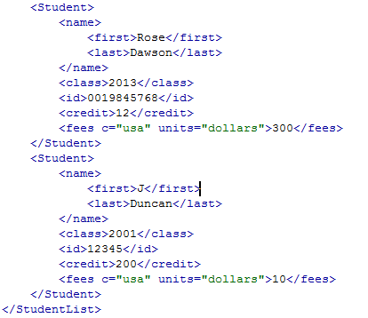
New Student (Group Work)
Write a short program to be able to enter new students. Save the data to the XML file:
>>>
Please enter the student's first name: J
Please enter the student's last name: Duncan
Please enter the student's class year: 2001
Please enter the student's id number: 12345
Please enter the student's credits: 200
Please enter the student's fees: 10
New student added.

Slide 15
New Student (Solution)
import xml.etree.ElementTree as ET
first = raw_input("Please enter the student's first name: ")
last = raw_input("Please enter the student's last name: ")
class_year = raw_input("Please enter the student's class year: ")
id_num = raw_input("Please enter the student's id number: ")
credit = raw_input("Please enter the student's credits: ")
fees = raw_input("Please enter the student's fees: ")
root = ET.parse(source="students.xml")
elements = root.getiterator()
student_list = elements[0]
new_student = ET.SubElement(student_list, "Student")
new_name = ET.SubElement(new_student, "name")
ET.SubElement(new_name, "first").text = first
ET.SubElement(new_name, "last").text = last
ET.SubElement(new_student, "class").text = class_year
ET.SubElement(new_student, "id").text = id_num
ET.SubElement(new_student, "credit").text = credit
new_fees = ET.SubElement(new_student, "fees")
new_fees.text = fees
new_fees.set("c", "usa")
new_fees.set("units", "dollars")
print "New student added."
root.write("students.xml")

Slide 16
Modifying XML
Removing an element:
import xml.etree.ElementTree as ET
root = ET.parse(source="students.xml")
elements = root.getiterator()
for elem in elements:
if elem.tag == "Student":
if elem.find("id").text == "12345":
root.getroot().remove(elem)
print "Student removed."
root.write("students.xml")

Slide 17
Namespaces in XML
The name of an element in XML is just a string
So our list of Students could include different types:
Informatics Students
Computer Science Students
Philosophy Students
How could we tell them apart?

Slide 18
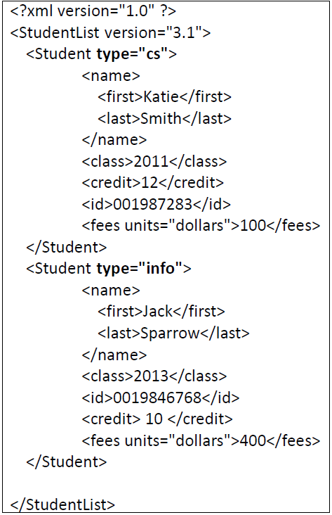
Namespaces in XML
We could use an attribute
But this is less searchable
Instead, we use namespaces

Slide 19
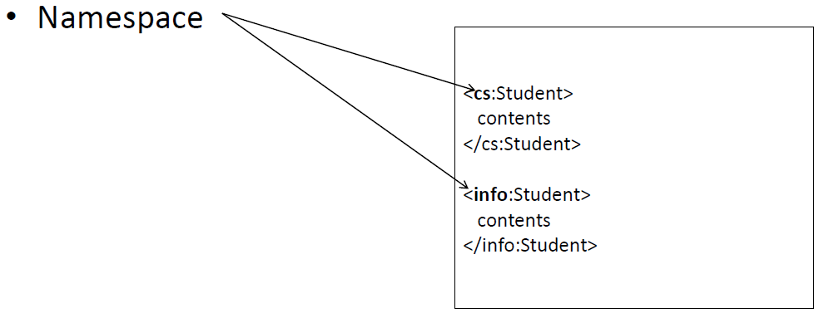
Namespaces in XML
The use of a namespace is indicated by the presence of a “:” in the elements’ name
Namespaces have to be declared and are usually associated with a URL

Slide 20
Namespaces in XML
<?xml version="1.0" ?>
<StudentList version="2.1" xmlns:info="http://www.soic.indiana.edu/" xmlns:phil="http://www.indiana.edu/~phil/">
<info:Student>
<name>
<first>Katie</first>
<last>Smith</last>
</name>
<class>2011</class>
<credit>12</credit>
<id>001987283</id>
<fees units = "dollars" c = "usa">100</fees>
</info:Student>
<phil:Student>
<name>
<first>Jack</first>
<last>Sparrow</last>
</name>
<class>2013</class>
<id>0019846768</id>
<credit>10</credit>
<fees units = "dollars" c = "usa">200</fees>
</phil:Student>
</StudentList>
Namespace declarations at the root node
Namespace use
Closing tags need it too!

Slide 21
Namespaces in XML
Download students_ns.xml
Before, we did this:
import xml.etree.ElementTree as ET
root = ET.parse(source="students.xml")
students = root.findall("Student")
print students
So, this will work, right?
import xml.etree.ElementTree as ET
root = ET.parse(source="students_ns.xml")
info_students = root.findall("info:Student")
print students

Slide 22
Namespaces in XML
Nope! We need to prepend the namespace to the element name!! Try this:
import xml.etree.ElementTree as ET
root = ET.parse(source="students_ns.xml")
info_students = root.findall("{http://www.soic.indiana.edu/}Student")
phil_students = root.findall("{http://www.indiana.edu/~phil/}Student")
print info_students
print phil_students

Slide 23
Namespaces in XML
The use of namespaces is very common in XML from the web
For example, view the IU Technology news feed: https://www.iu.edu/~iunews/services/newsrooms/feeds/?format=rss20&id=1232a17b814f4e1c77a8fb801f237996&sort=date
Let’s work with this feed!

Slide 24
Namespaces in XML
https://www.iu.edu/~iunews/services/newsrooms/feeds/?format=rss20&id=1232a17b814f4e1c77a8fb801f237996&sort=date
This pulls the page (as a string containing XML) and parses it into the structure we’re used to: Try it!
import urllib, xml.etree.ElementTree as ET
conn = urllib.urlopen("https://www.iu.edu/~iunews/services/newsrooms/feeds/?format=rss20&id=1232a17b814f4e1c77a8fb801f237996&sort=date")
lines = conn.read()
conn.close()
root = ET.XML(lines)
print root.tag #this just prints out 'rss'

Slide 25
Namespaces in XML
We’re interested in getting the source/credit of the new feed
View the page source and look at the top to see the namespace declaration:
<rss xmlns:media="http://search.yahoo.com/mrss/" version="2.0">
So let’s try adding this:
news_items = root.findall("{http://search.yahoo.com/mrss/}credit")
print news_items
Does it work?

Slide 26
Namespaces in XML
Look at the file again… what the path to the text element?
channel/item/…
So we change it to:
news_items = root.findall("channel/item/{http://search.yahoo.com/mrss/}credit")
print news_items
It’s all about finding the right path!!

Slide 27
News Titles (Group Work)
Print the title and credit of each news item from 2014 in the feed like this:
>>>
Current News Items:
--------------------------------------------------------------------------------
Title: IU Research and Technology Corp. signs licensing agreement to expand Critical Web Reader globally
Credit: Indiana University
Date: Tue, 15 Jul 2014 00:00:00 EDT
--------------------------------------------------------------------------------
Title: Dennis Groth named vice provost for undergraduate education at IU Bloomington
Credit: Indiana University
Date: Mon, 7 Jul 2014 00:00:00 EDT
--------------------------------------------------------------------------------
Title: Von Welch named new leader of IU's Center for Applied Cybersecurity Research
Credit: Indiana University
Date: Tue, 1 Jul 2014 00:00:00 EDT
--------------------------------------------------------------------------------
Title: Star Trak: July 2014
Credit: Indiana University
Date: Tue, 1 Jul 2014 00:00:00 EDT
--------------------------------------------------------------------------------
Title: IU informaticist Y.Y. Ahn named one of seven Microsoft Research Faculty Fellows
Credit: Indiana University
Date: Thu, 12 Jun 2014 00:00:00 EDT
--------------------------------------------------------------------------------
Etc.

Slide 28
News Titles (Solution)
import urllib, xml.etree.ElementTree as ET
conn = urllib.urlopen("https://www.iu.edu/~iunews/services/newsrooms/feeds/?format=rss20&id=1232a17b814f4e1c77a8fb801f237996&sort=date")
lines = conn.read()
conn.close()
root = ET.XML(lines)
print "Current News Items:\n", "-" * 80
news_items = root.findall("channel/item")
for news in news_items:
if "2014" in news.find("pubDate").text:
print "Title:", news.find("title").text
print "Credit:", news.find("{http://search.yahoo.com/mrss/}credit").text
print "Date:", news.find("pubDate").text
print "-" * 80

Slide 29
Questions?

